Slide 1

Transform Your Morning Coffee Routine
Cut your morning coffee time from 23 minutes to 10 minutes—a 56% reduction. Discover how Lean principles can save you 79 hours annually while improving quality and reducing stress.

Slide 2
Current State: The Problem
23
78%
8
12
Minutes Daily
Waste Time
Motion Events
Process Steps
Current total cycle time
Non-value-added activities
Unnecessary movements
Total steps in routine
Your morning routine is filled with inefficiencies: walking between locations, searching for items, waiting idly, and repeating unnecessary steps. Only 22% of your time adds actual value.

Slide 3
The 7 Types of Waste
TIM WOOD Framework Analysis
Transportation
Inventory
Walking bed → kitchen → back: 1 min lost
Multiple storage locations: 2 min lost
Motion
Waiting
Searching cabinets, reaching: 4 min lost
Idle during brewing: 7 min lost
Over-production
Over-processing
Defects
Getting all items at once: 1 min
Extra measuring steps: 2 min
Wrong mug, spills: 1 min
Total waste identified: 18 minutes (78% of routine)

Slide 4
Five Key Improvements
01
02
03
Coffee Station Organization (5S)
Night-Before Prep
Single-Serve Method
Prepare before bed: place mug, pre-measure coffee, position water pitcher. Saves 2 minutes.
Switch to coffee pods, AeroPress, or instant. Eliminates waiting and over-processing. Saves 2 minutes.
Create dedicated station with all items pre-positioned. Saves 3-4 minutes by eliminating motion, inventory, and waiting waste.
04
05
Productive Multitasking
Batch Consolidation
During 5-min brew: toast bread, prep breakfast, stretch. Converts idle time into value.
Store milk, sugar, spoon in one pre-assembled container. Saves 1 minute.

Slide 5
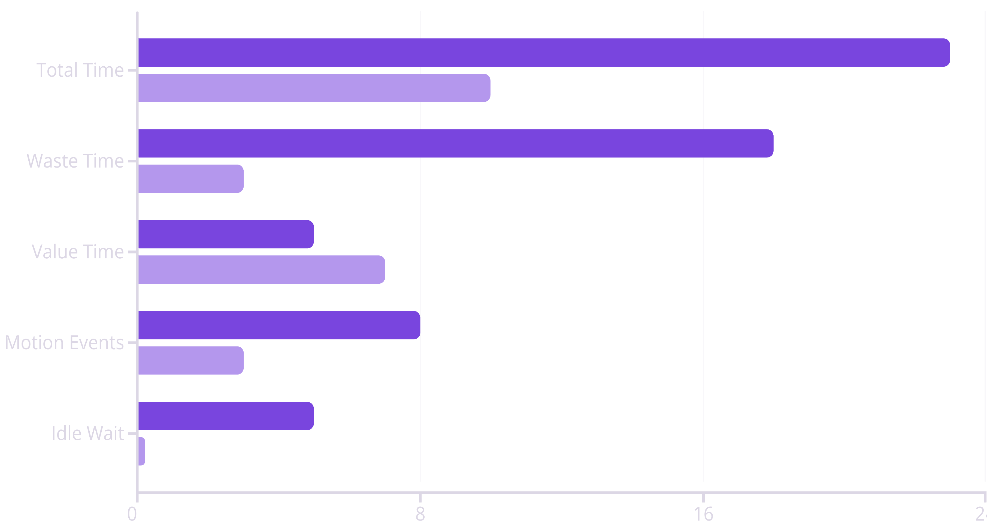
Before vs. After Comparison
Before
After
Quality Improvements
Key Results
Consistency: Variable → Standardized
56% faster process
Mental Clarity: Low → High
83% waste reduction
Stress Level: High → Low
40% more value-added time
Morning Mood: Frustrated → Calm
100% elimination of idle waiting

Slide 6




Your Annual ROI
79 Hours Saved
13
91
6.5
Minutes
Minutes
Hours
Saved daily
Saved weekly
Saved monthly
What You Can Do with 79 Hours
📚 Read 3-4 books
💪 Exercise regularly
👨‍👩‍👧 Quality family time
🎓 Take an online course
😴 Sleep 3-4 extra hours/week
🎨 Work on side projects
Implementation cost: 5 hours + $20-50 in supplies = 1,480% ROI

Slide 7
5-Week Implementation Roadmap
Week 1: Planning & Understanding
1
Time your current routine for 3 days. Plan station layout. Gather supplies. Clean coffee maker. Target: 23 min baseline
2
Week 2: Implement 5S Coffee Station
Arrange all items in workflow order. Label each item. Test layout 2-3 times daily. Target: 19-20 min (3-4 min saved)
Week 3: Night-Before Prep
3
Create setup checklist. Place mug, pre-measure coffee, position water pitcher each night. Execute 7 times. Target: 10-11 min (2 more min saved)
4
Week 4: Multitasking & Consolidation
Prep breakfast during brew. Start toasting bread. Create batch container for milk/sugar/spoon. Target: 10 min (full 13 min saved)
Week 5: Stabilize & Continuous Improvement
5
Run optimized process daily. Track time each morning. Ask "What could be faster?" Build continuous improvement mindset. Target: Stable new process

Slide 8









9 Lean Principles Applied
Value Specification
Value Stream Mapping
Continuous Flow
Quality coffee, quick routine, minimal effort
12 steps identified, 78% waste found
Organized station, no interruptions
Pull System
Jidoka
5S Methodology
Night-before prep, demand-driven
Station organization prevents mistakes
Sort, Set, Shine, Standardize, Sustain
Standard Work
Kaizen
Visual Management
Same steps, same order every day
Weekly optimization, small improvements
Checklist card, labels, clear organization

Slide 9
Expand Lean to Your Entire Morning
Apply the same framework to other routines and save even more time:
Morning Task
Current
Target
Savings
☕ Coffee
23 min
10 min
-13 min
🚿 Shower/Prep
20 min
12 min
-8 min
🍳 Breakfast
12 min
7 min
-5 min
👔 Getting Dressed
8 min
5 min
-3 min
🚗 Commute Prep
7 min
4 min
-3 min
TOTAL MORNING
70 min
38 min
-32 min
195 Hours
Annual savings if applied to all morning routines
The framework is universal. Apply Lean to email management, project workflows, meeting prep, document creation, and team processes.

Slide 10


You're Ready to Start!
What You've Learned
Your Next Steps
The 5 steps of Lean thinking
TODAY: Commit for 5 weeks
How to identify waste (TIM WOOD)
WEEK 1: Time your current routine (3 days), plan station layout
The 5S methodology for organization
Specific improvements for your routine
WEEKS 2-4: Implement improvements one by one
How to save 13+ minutes daily
How to build continuous improvement mindset
Remember: Consistency beats perfection (80% is good enough). Small improvements compound into big results.
Transform Your Life
Lean is a journey, not a destination. 79 hours per year is a life-changing opportunity. Start with coffee, transform your entire life.

